Slide 1
Schedule-based Harmonic Playlist Generation using Neural Networks
Team Members:
Rym Benchaabane
Javier Garcia Gonzalez
Rhema Ike
Monday, May 4th

Slide 2
Introduction
Music is present in a users daily life and increases productivity
Many playlist generation methods already exist according to a specific activity
Novelty: Generating a playlist according to a listener schedule and implementation of harmonic mixing

Slide 3
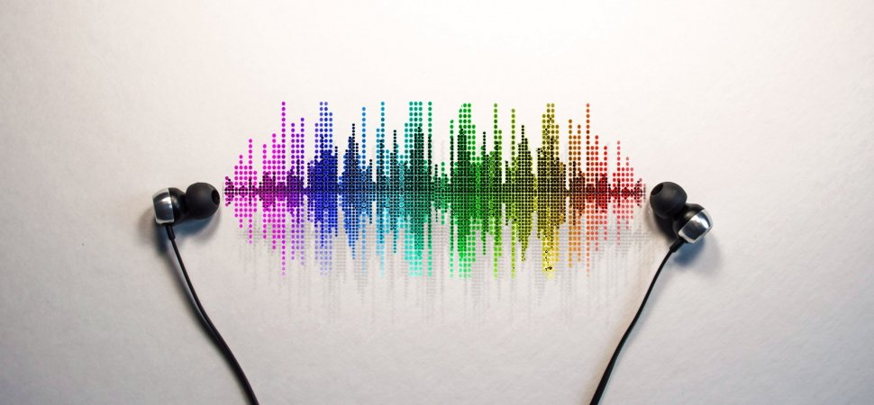
Overview
Related Works
Methods
Results
Conclusion and Future Work

Slide 4
Related Works
Germain and Chakareski
Bohra
Pauws and Egen
Similarities:
Generation of Playlist
Content-based filtering
Differences:
No Camelot Wheel
No TensorFlow
Song choice not based on an entire schedule
User like history from social media
Similarities:
Classify songs in activities
Differences:
No implementation of Camelot Wheel
Song choice not based on an entire schedule
Uses Bayes Variation Method
Similarities:
Classify songs in categories
Neural Network
Differences:
18 features instead of 11
No consideration of a schedule
Only 2 categories
Feedback from listener approval

Slide 5
Related Work
Olivier & Kreger-Stickles
Irene
Similarities:
Focus on structure of playlist
Implementation of RNN (LSTM)
Differences:
No Camelot Wheel
No TensorFlow
Song choice not based on an entire schedule
Similarities:
Context Aware
Clustering
Work Out Application
Differences:
Implementation of physiological feedback
Tree Method
Song choice not based on an entire schedule

Slide 6
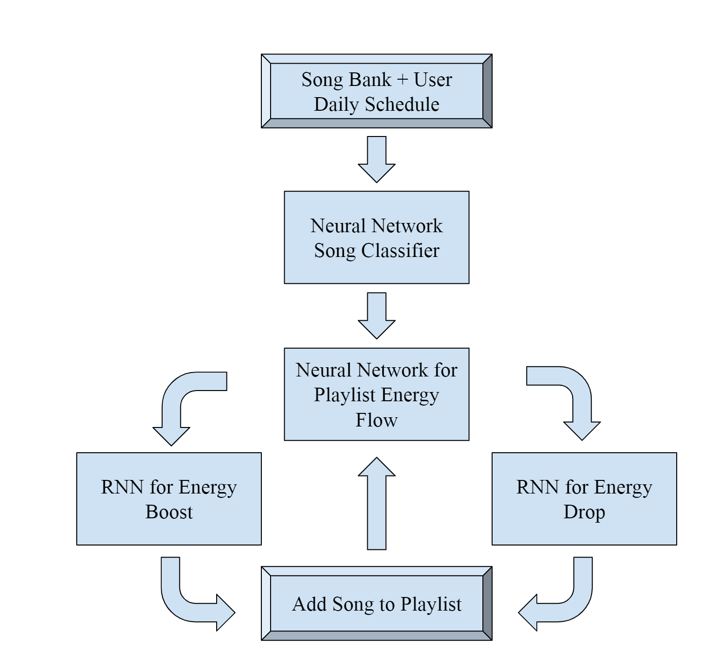
Methods overview
Main tools:
MATLAB
Python
TensorFlow

Slide 7

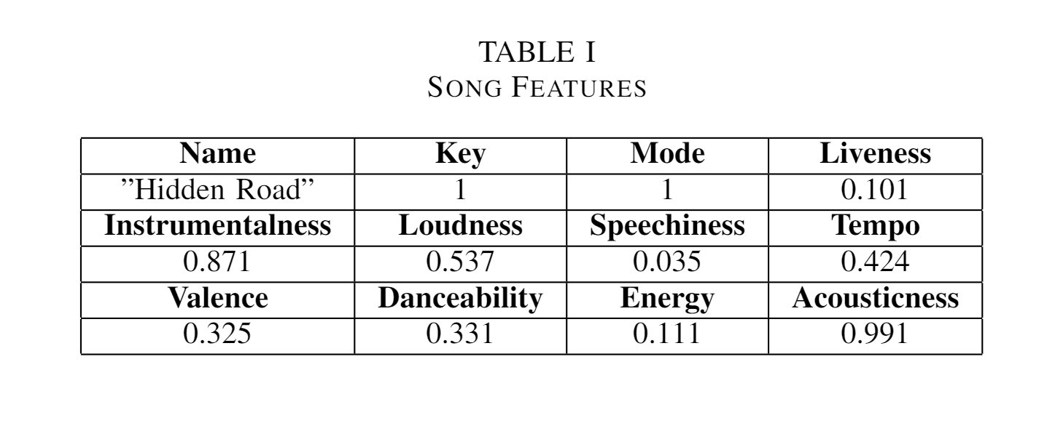
Data Acquisition
Song Bank:
4000 Songs
** We normalized the Data!!

Slide 8
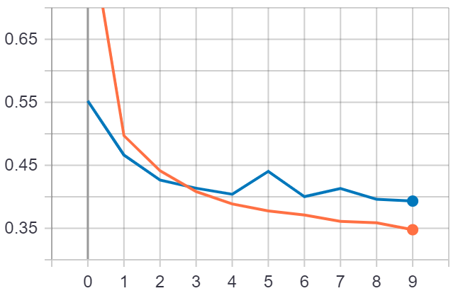
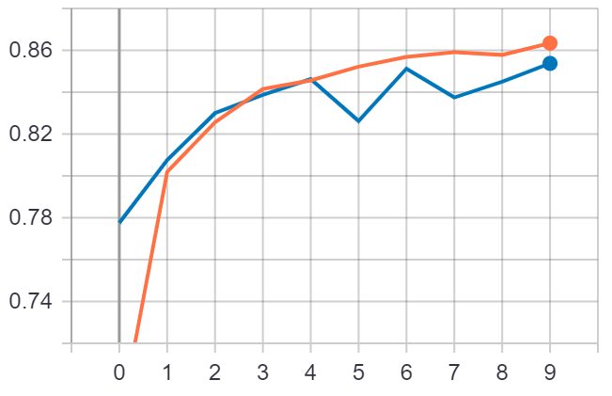
Pattern Recognition Neural Network
for Song Classification
Accuracy
Validation
Cost Function
Activities:
Beast Mode Gym
Studying
Beach Party
Relaxing
Cost
Epochs
Training Accuracy
Accuracy
Epochs

Slide 9
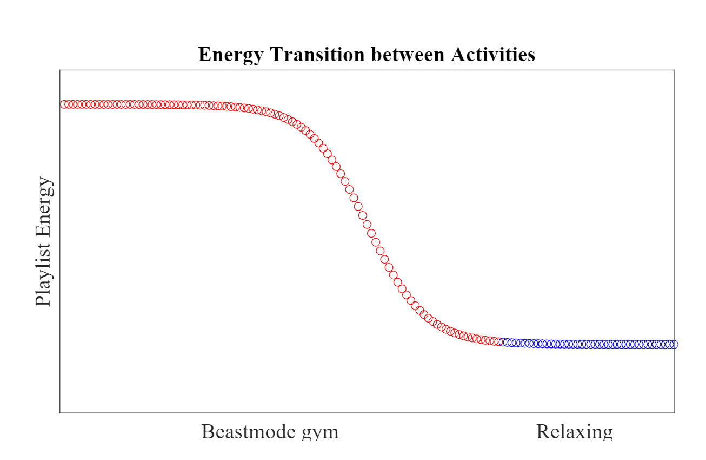
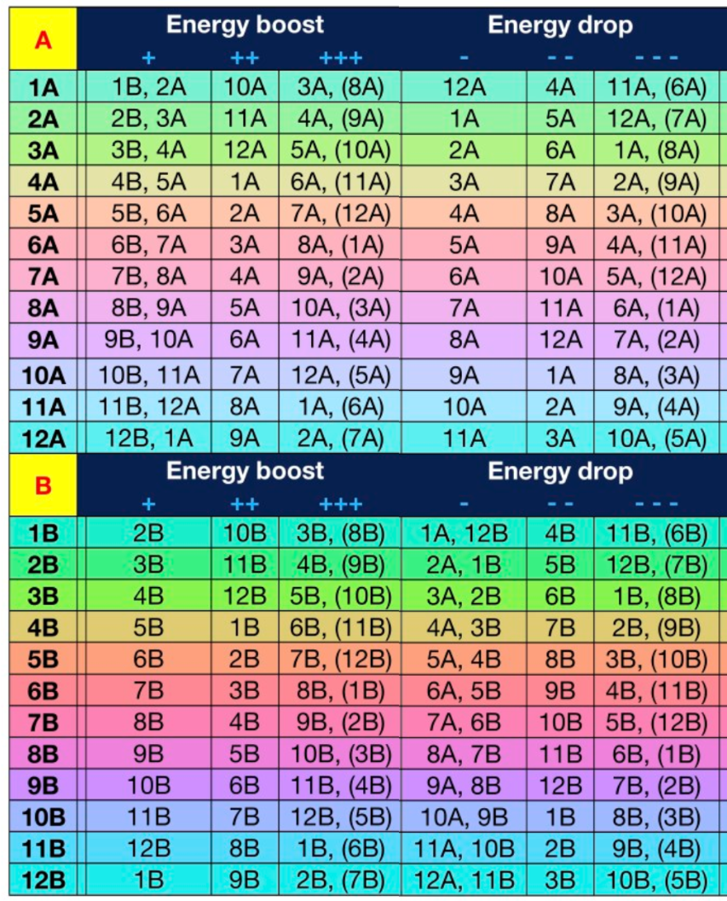
1
0
Neural Network for Energy Flow
Energy Transition Between Activities
Time Remaining between 2 activities
Checks for every 30 seconds for a total of 3841 Data Points
Playlist Energy
Studying Beach Party

Slide 10
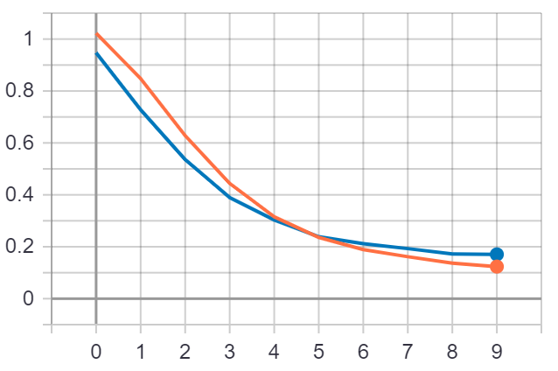
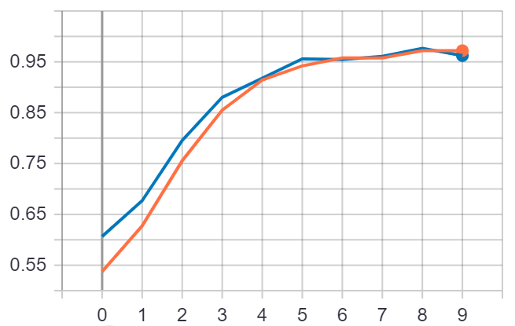
Neural Network for Energy Flow
Cost Function
Accuracy
Validation
Cost
Training Accuracy
Epochs
Accuracy
Epochs

Slide 11
Recurrent Neural Network for Energy Change
RNN consists of
Three hidden layers
Two LSTM layers
Application of Camelot Wheel for harmonic mixing

Slide 12
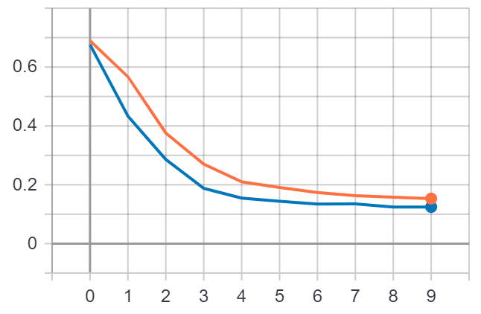
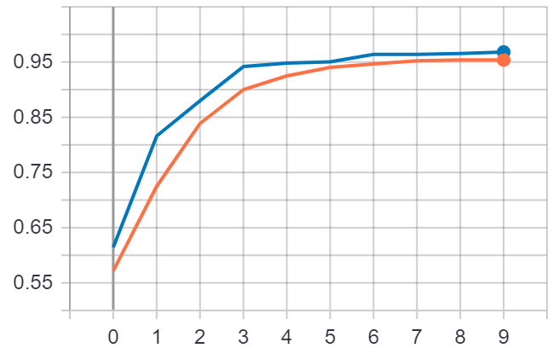
Recurrent Neural Network for Energy Boost
Accuracy
Validation
Cost Function
Training Accuracy
Cost
Accuracy
Epochs
Epochs

Slide 13
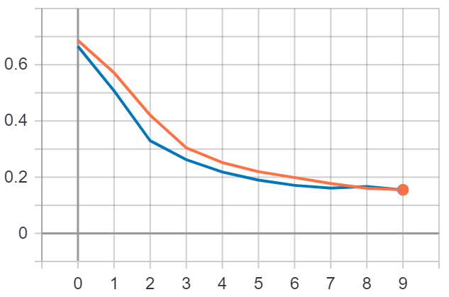
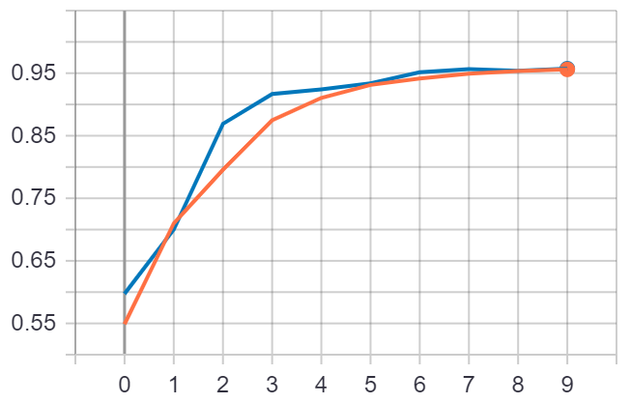
Recurrent Neural Network for Energy Drop
Accuracy
Validation
Cost Function
Training Accuracy
Cost
Accuracy
Epochs
Epochs

Slide 14
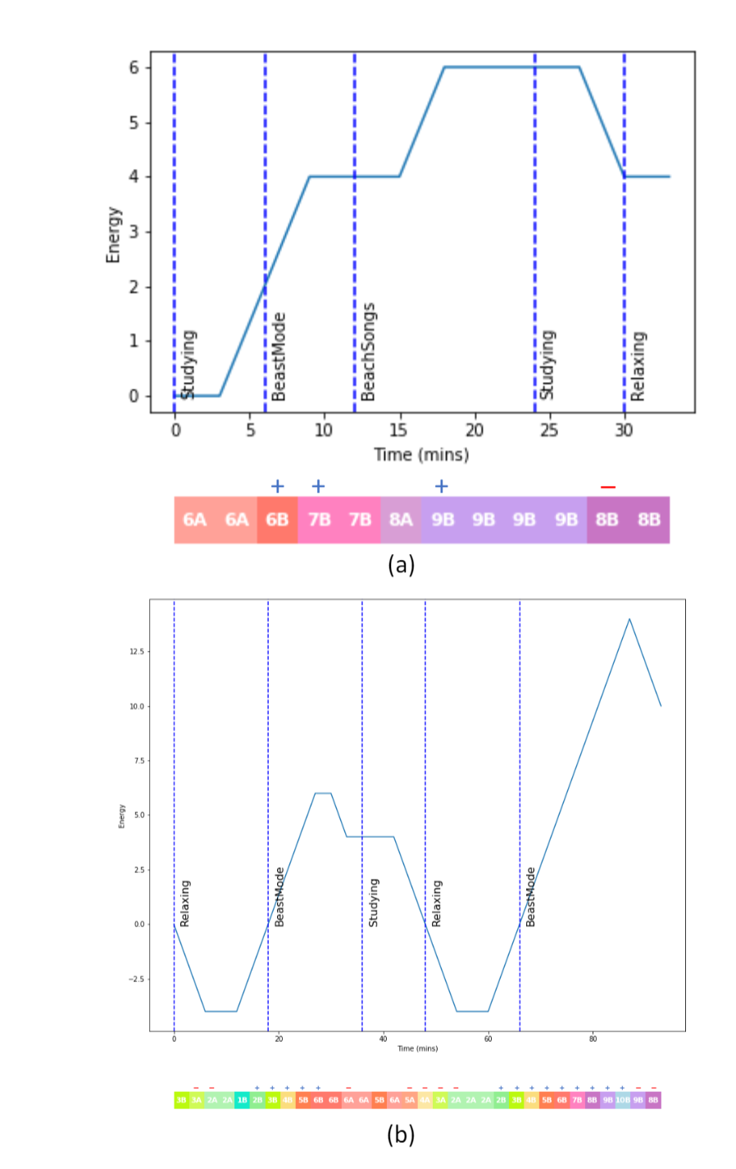
Results
Energy flow of generated schedules based playlists

Slide 15
Project Demonstration
Professor, give us your schedule
Activity Options
Beast Mode (Gym)
Studying
Beach
Relaxing
Pick Durations (in Hrs)

Slide 16
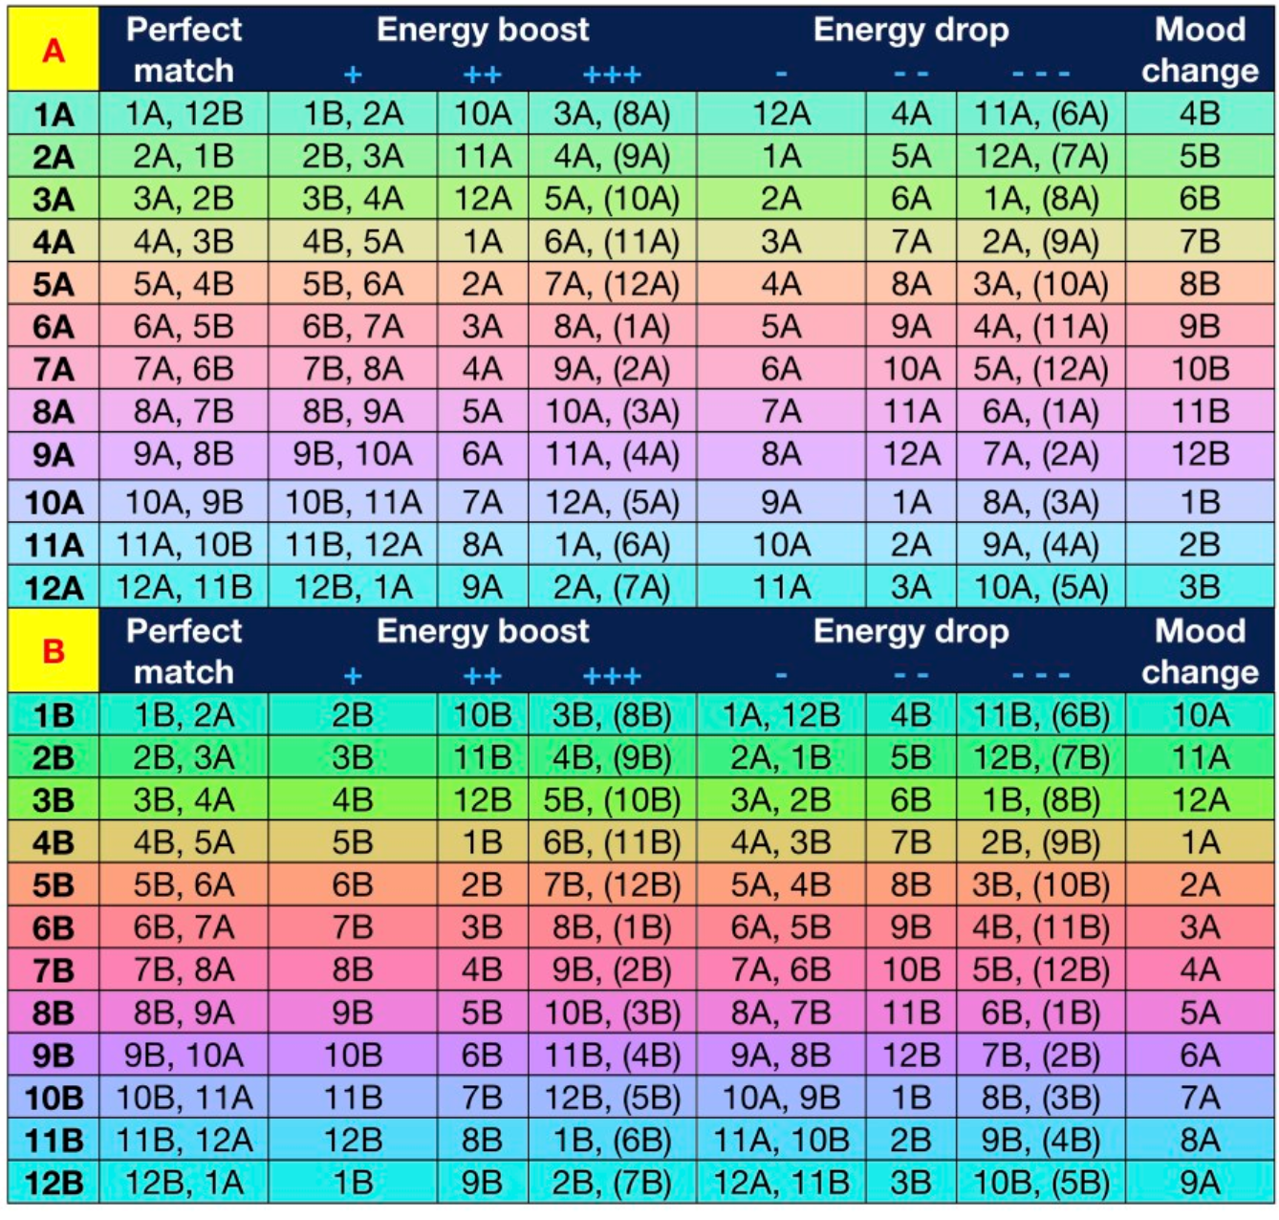
Conclusion and
Future Work
Novelty:
Scheduled Playlist for several activities
Energy Changes from Camelot Wheel
Multi-Stage NN
Future Work
Expanding number of activities
Implementing more levels of energy changes
Incorporating the tempo in transition choice
Considering listening feedback on generated playlist

Slide 17
References
R. T. Irene, C. Borrelli, M. Zanoni, M. Buccoli and A. Sarti, "Automatic playlist generation using Convolutional Neural Networks and Recurrent Neural Networks," 2019 27th European Signal Processing Conference (EUSIPCO), A Coruna, Spain, 2019, pp. 1-5.
Parker, Joseph. “Camelot Wheel Tricks to Advance Your DJ Skills.” Best DJ Gear, www.bestdjgear.net/camelot-wheel-tricks-to-advance-your-dj-skills/.
J. G. Fox and E. D. Embrey, "Music - an aid to productivity," Applied Ergonomics, 3(4), 1972, pp. 202–205.
D. J. Blood and S. J. Ferriss, "Effects of Background Music on Anxiety, Satisfaction with Communication, and Productivity," Psychological Reports, 72(1), 1993, pp. 171–177.
11. C. Sun et al. "The effect of different types of music on electroencephalogram" 2013 IEEE International Conference on Bioinformatics and Biomedicine pp. 31-37 2013.
A. Germain and J. Chakareski, "Spotify Me: Facebook-assisted automatic playlist generation," 2013 IEEE 15th International Workshop on Multimedia Signal Processing (MMSP), Pula, 2013, pp. 025-028.
T. S. Bohra, V. Kumar and S. Ganesan, "Segmenting music library for generation of playlist using machine learning," 2015 IEEE International Conference on Electro/Information Technology (EIT), Dekalb, IL, 2015, pp. 421-425.
S. Pauws and B. Eggen, "PATS: Realization and User Evaluation of an Automatic Playlist Generator," 3rd International Conference on Music Information Retrieval (ISMIR), Paris, France, 2002.
N. Oliver and L. Kreger-Stickles, "PAPA: Physiology And Purpose-Aware Automatic Playlist Generation," 7th International Conference on Music Information Retrieval (ISMIR) Victoria, Canada, 2006, pp. 250-253.

